Slide 1
ECG signal analysis using deep neural networks
Author: Jani Bizjak
Mentor: prof. dr. Igor Kononenko
Notes:
RESTARTI TIMER!!

Slide 2
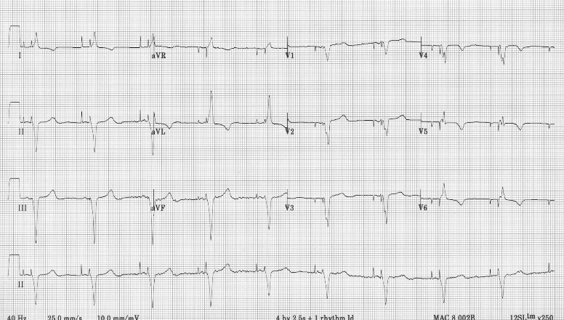
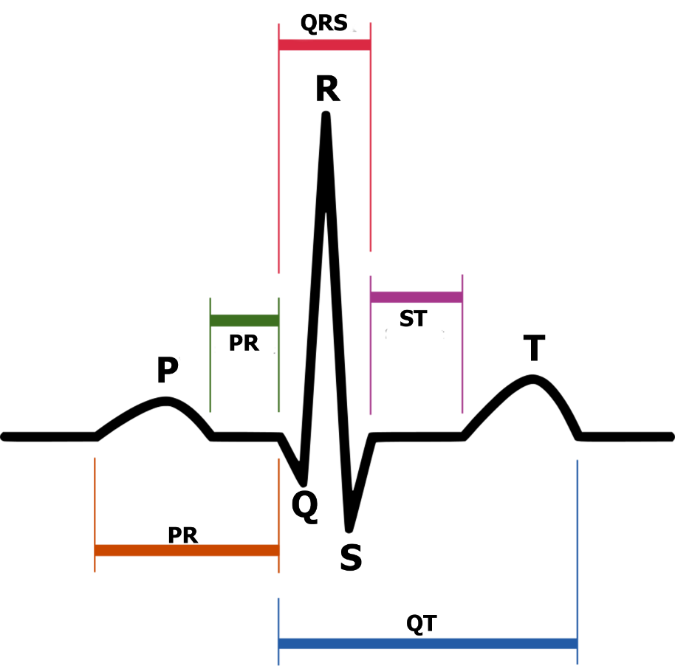
Electrocardiogram - ECG
ECG measures electrical conductivity of skin
Standard:
10 electrodes
12 leads
Signal shape – PQRST
Normal sinus rhythm
Notes:
Kaj EKG meri
Kaj elektrode so, pogosto število
Standardna postavitev, kaj se spreminja glede na postavitev, odvodi/posnetki
Izpis signala z EKG -> PQRST (opis valov)
Kaj je normalni sinusni ritem.
QRS kompleks je na sledi aVl, V5, V6

Slide 3
Heart diseases – Premature contraction
Premature atrial contraction (PAC)
Looks normal
Premature junctional complex (PJC)
Signal starts in atrioventricular node
Premature ventricular contraction(PVC)
Signal starts in Purkinje fibers
Classification
Bigeminy
Trigeminal
Quadrigeminal
Couples
Triplets
Notes:
PAC: prezgodenj utrip
PJC: brez vala P
PVC: sprememba vala ST in T

Slide 4
Deep neural networks
1954 – first implementations
Perform worse than other methods of ML
21. century – development of computer graphic cards
Deep neural networks dominate areas of:
Computer vision
Speech recognition
Natural language processing

Slide 5
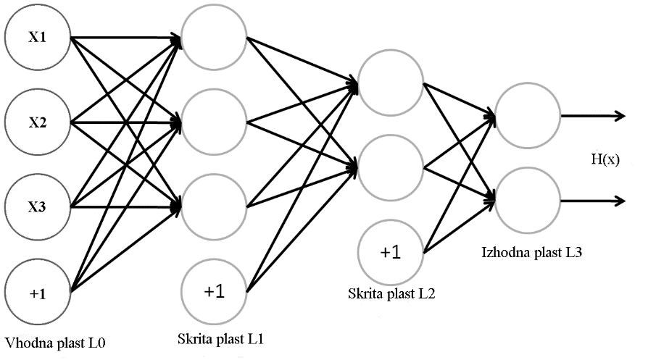
Neural network
Feed forward neural network
Back propagation
Optimization of gradient descend
Stochastic gradient descend
ADaGrad
ADaDelta
RMSProp
Notes:
Feedforward = razširjanje naprej

Slide 6
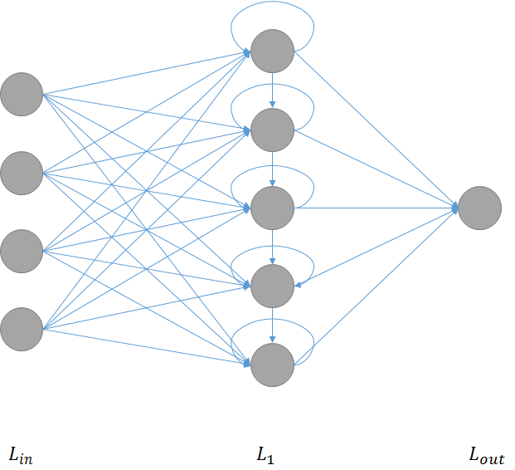
Recurrent neural networks
Neurons connected within layers
Can recognize (time) dependencies in data
Memory problem:
Gradient explosion
Zero gradient
Long-short term memory (LSTM)

Slide 7
ECG signal analysis – dataset
ECG dataset on PhysioNet: MIT-BIH
47 persons
48 x 30 minute recordings
75.000 normal sinus rhythm, 2.500 PAC, 8.00 LBBB, 7.000 RBBB, 7.000 PVC
Annotated by two medical doctors
Errors in annotation exist

Slide 8
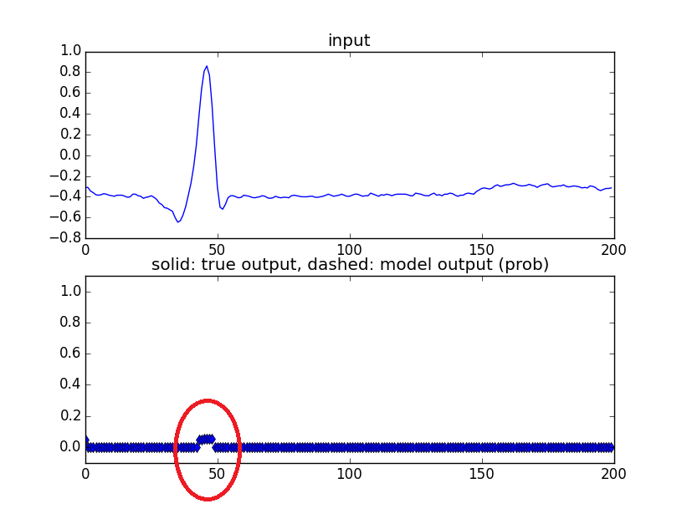
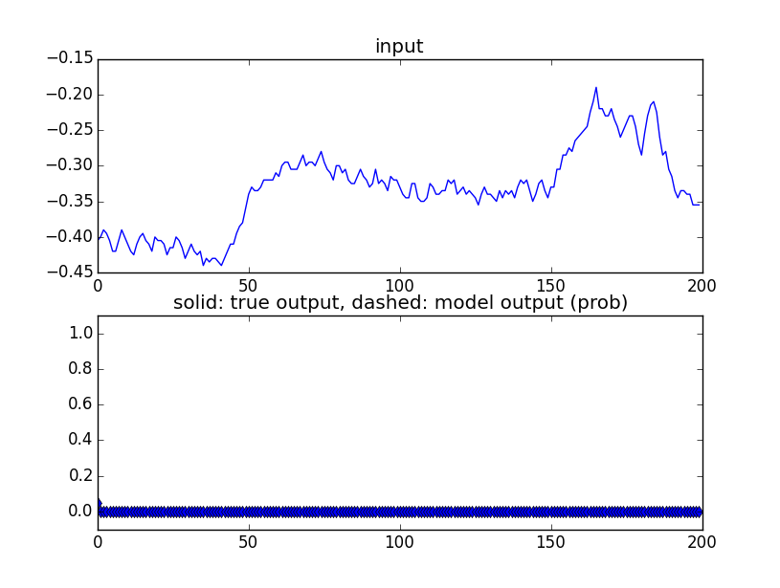
Detecting QRS complex
Classification accuracy 99,7%
Learning time 1 day

Slide 9
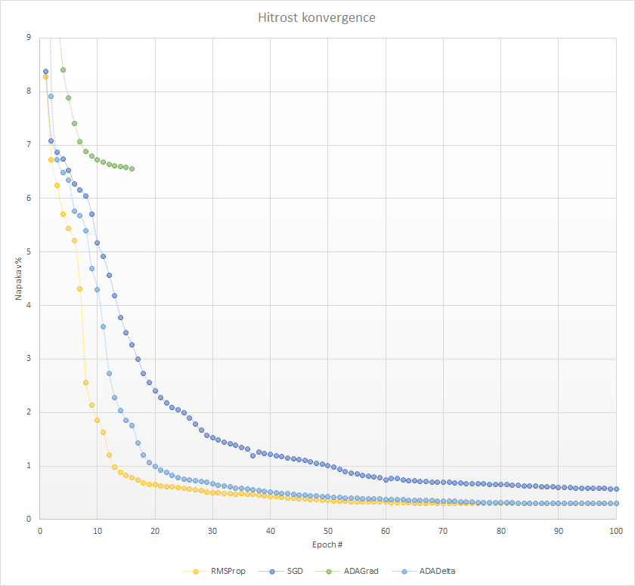
Gradient descend optimization
SGD: $θ=θ−α∆F$
AdaGrad:
$v=v+{\left(∆F\right)}^{2}$
$θ=θ+α\frac{∆F}{\sqrt{v}+ε}$
Adadelta: $v=v∗m+ \frac{1}{1+ e^{−t/5}}{(∆F)}^{2}$
RMSProp:
$v=βv+(1−β){(∆F)}^{2}$
$θ=θ−α\frac{∆F}{\sqrt{v}+ε}$

Slide 10
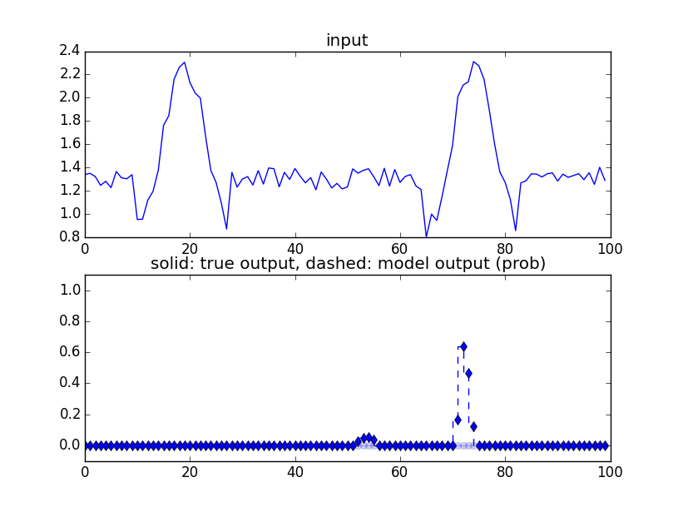
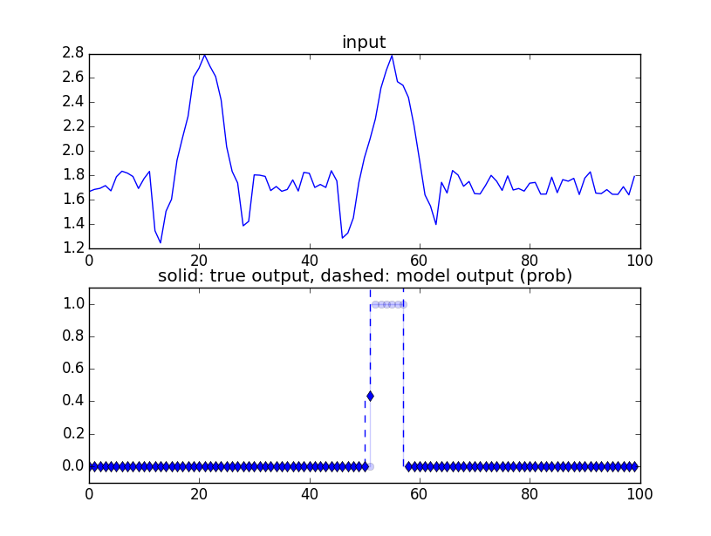
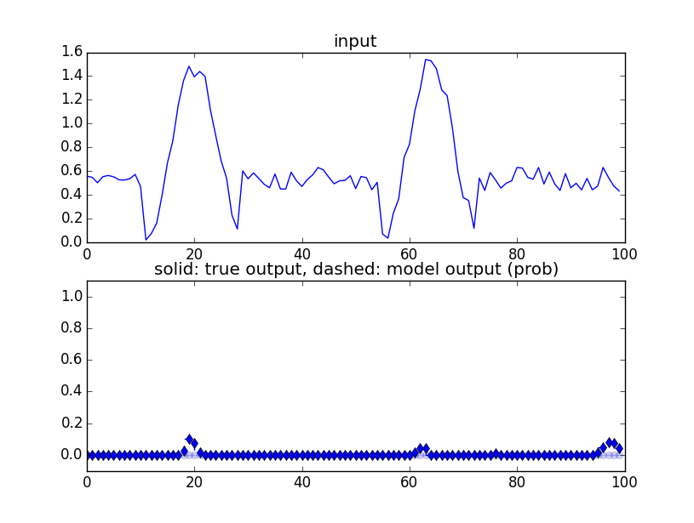
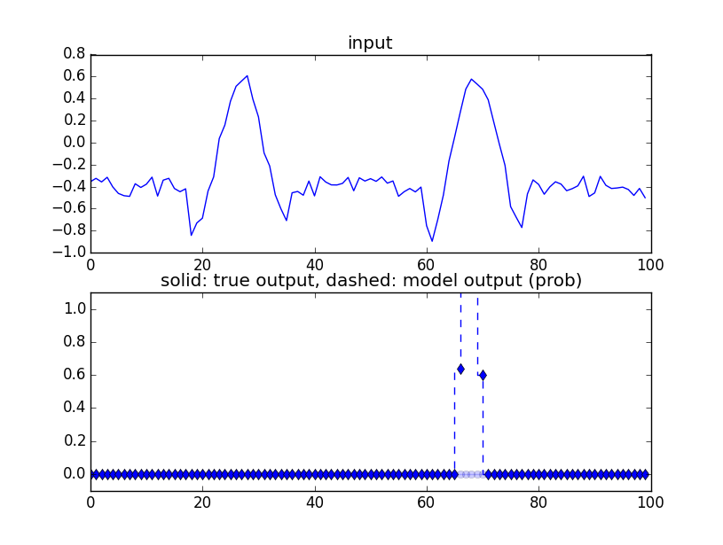
Detecting premature contraction
Problems of long term memory
Synthesis of artificial dataset
Classification accuracy 94,7%

Slide 11
Conclusion and future work
QRS complex detection with accuracy 99,7%
Premature contraction detection 94,7 %*
Comparable to other state of the art methods
Future work:
Further optimization of gradient descend
Implementation of LSTM
Combining RNN with CNN neural networks

